Slide 1
Information Communication Technologies
Teacher: Smaiyl Assel Maralbayevna

Slide 2
Outline
1. General introduction about the course
2. Course Plan

Slide 3
1. General introduction about the course

Slide 4
What do I expect from you?
Full attendance;
Participation to the class discussions;
Interesting ideas;
Submission of assignments on time;

Slide 5
Course Policy
Students are forbidden to:
submit any tasks after the deadline. Late submissions are graded down (20% per day).
cheat. Plagiarized papers shall not be graded (ZERO);
be late for classes. Being tardy three times amounts to one absence;
use mobile phones in class;
Students should always
be appropriately dressed (formal/semi- formal styles are acceptable);
show consideration for and mutual support of teachers and other students;
let the teacher know of any problems arising in connection with their studies

Slide 6
Learning and Feedback
Feedback for lab works will be given during defense
For other questions email me (assel.smaiyl@astanait.edu.kz)

Slide 7
Course Materials
platonus (Look for Database)
Slides for every session will be available
A number of texts in Library
‒ Database Systems - A Practical Approach to Design, Implementation, and Management, Connolly & Begg
‒ Fundamentals of Database Systems, Elmasri & Navathe

Slide 8
Course characteristics
Discipline type: Basic discipline
Course duration: 1 trimester
Duration: 10 weeks
1 week : 5 hours + 1 Office Hour

Slide 9
Course requirements
Requirements for this course:
PC or Laptop
PostgreSQL (open source, supports both Windows, Linux and MacOS)
Microsoft Visio Pro, draw.io (open source) or another similar drawing application for producing Entity Relationships Diagram (ERD).

Slide 10
Course description
This course is developed to learn the introduction to ICT and the idea of computer systems, and understanding of database technology, database design and the basics of the database programming as well. Students acquire the concepts of relational databases, design & implement SQL databases, and gain extensive practical experience working on practice tasks and term project.

Slide 11
Course Plan
1. ICT introduction. Computer Systems. Data Representation
Definition of ICT
Overview of computer systems
Hardware and software
Data representation
2. Introducing the Database. What is DBMS. Why database design is important?
Role and Advantages of the DBMS
Types of Databases
DBMS Functions
3. Data Models
Data Model Building Blocks (Attribute, Entity, Relationships)
Relational Model
4. SQL Development. DDL Statements.
Data Types & Constraints
DDL commands

Slide 12
Course Plan
5. SQL Development. DML Statements.
DML insert
DML update
DML delete
SELECT queries with WHERE clause (Order by, Aggregate Functions, Grouping Data)
Midterm Exam questions review
6. DBMS Normalization
First Normal Form (1NF)
Second Normal Form (2NF)
Third Normal Form (3NF)

Slide 13
Course Plan
7. JOIN Operators
Inner Join
Left Join
Right Join
Full Join
8. SQL Subqueries
FROM
WHERE
9. Final Project Iteration 1
10. Final Project Deliverable
Presentation
Final submission

Slide 14
Evaluation system
Period | Assignments | Number of points | Total
1st attestation | Laboratory works: 1 assignment, 2 assignment, 3 assignment, 4 assignment, 5 assignment Quizzes: 1 2 3 4 Midterm | 50 10 10 10 10 10 20 5 5 5 5 30 | 100

Slide 15
Evaluation system
Period | Assignments | Number of points | Total
2nd attestation | Laboratory works: 6 assignment, 7 assignment, 8 assignment, 9 assignment, Course work Quizzes: 1 2 3 4 Endterm | 50 10 10 10 10 10 20 5 5 5 5 30 | 100
Final Exam | Individual Project |  | 100
Total | 0,3*1stAtt+0,3*2ndAtt+0,4*Final |  | 100

Slide 16
Chapter 1. ICT introduction. Computer Systems. Data Representation

Slide 17
ICT introduction
Information communication technologies (ICT) refers to technologies that provide access to information through telecommunications. It is similar to Information Technology (IT), but focuses primarily on communication technologies. This includes the Internet, wireless networks, cell phones, and other communication mediums.
Information technology (IT) is the use of any computers, storage, networking and other physical devices, infrastructure and processes to create, process, store, secure and exchange all forms of electronic data.

Slide 18
What is a computer?
- An electronic device that is programmed to accept data, process data into useful information and store it for later use
- Computer consists of hardware and software
- Relationship between hardware and software

Slide 19
What is software?
- Software is a set of data or computer instructions;
- Software receives data from the user and processes it through the computer to produce output;
- Software is responsible for how computer interacts with user;
- Software divides into two categories: operating system (OS) software and application software;
- OS software controls all activities and resources of a computer, and manages the interconnection between computer and users. (Ex: Microsoft Windows, Unix, Mac OS)
- Application software is a collection of programs that helps users to carry out the task. (Microsoft Word, Game programs, Databases, Graphics software).

Slide 20
Hardware
Hardware – is a collection of physical electronic components of digital computer. All tangibles elements including CPU, motherboard, headphones, mouse and etc.

Slide 21
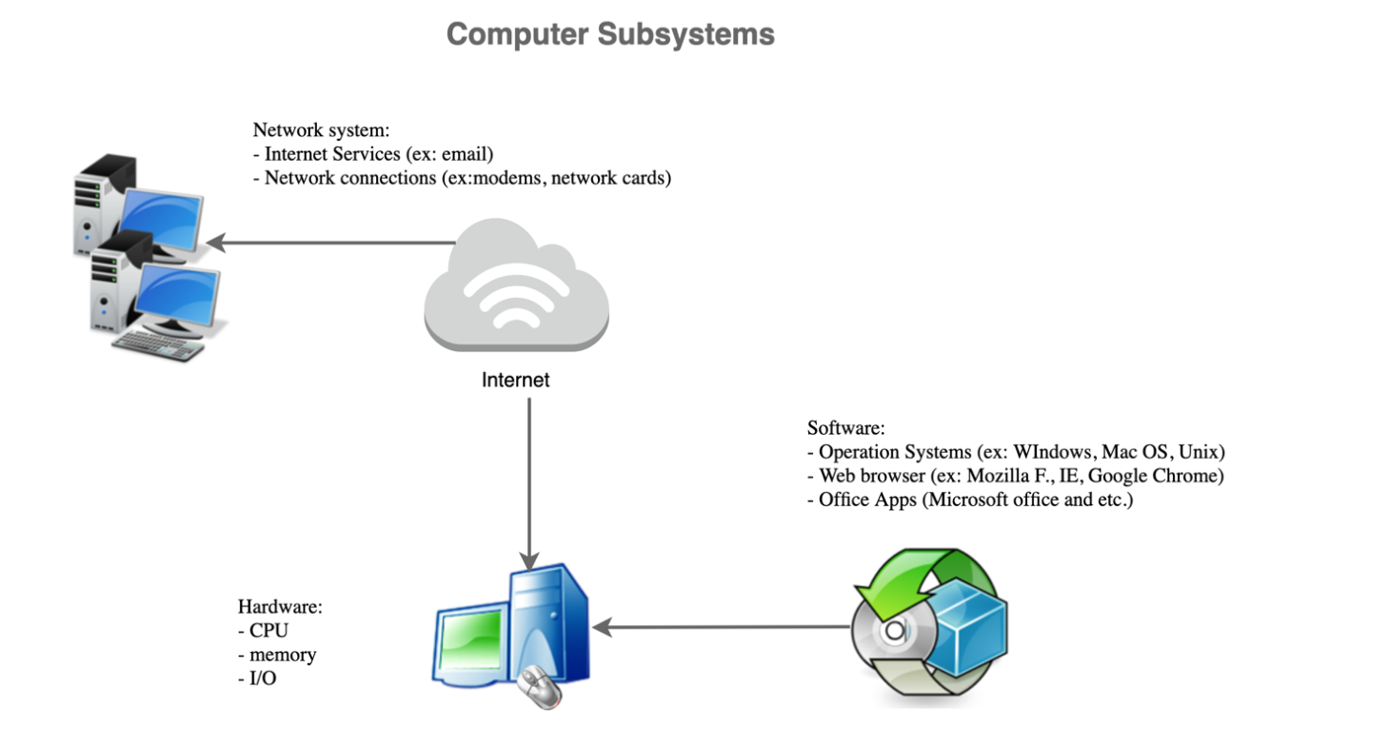
Computer Subsystem

Slide 22
Hardware Components
The central processing unit (CPU) is the main subsystem of the computer. It performs the operations on data. It has three parts: an arithmetic logic unit (ALU), a control unit and a set of registers, fast storage locations.
Main memory- consists of a collection of storage locations, each with a unique identifier, called an address. Data is transferred to and from memory in groups of bits called words.

Slide 23
Hardware Components
- Data word - A word can be a group of 8 bits, 16 bits, 32 bits or 64 bits (and growing). If the word is 8 bits, it is referred to as a byte. The term “byte” is so common in computer science that sometimes a 16-bit word is referred to as a 2-byte word, or a 32-bit word is referred to as a 4- byte word.
- Address space to access a word in memory requires an identifier. Although programmers use a name to identify a word (or a collection of words), at the hardware level each word is identified by an address. The total number of uniquely identifiable locations in memory is called the address space. For example, a memory with 64 kilobytes and a word size of 1 byte has an address space that ranges from 0 to 65,535.

Slide 24
Memory units
Unit | Number of Bytes | Approximation
Kilobyte | 2¹⁰ (1024 bytes) | 10³
Megabyte | 2²⁰(1,048,576) | 10⁶
Gigabyte | 2³⁰(1,073,741,824) | 10⁹
Terabyte | 2⁴⁰ | 10¹²

Slide 25
Example
Example 1.1 A computer has 32 MB (megabytes) of memory. How many bits are needed to address any single byte in memory?

Slide 26
Example
Example 1.2. A computer has 128 MB of memory. Each word in this computer is eight bytes. How many bits are needed to address any single word in memory?

Slide 27
Memory types
RAM (random access memory) is a temporary holding area for both data and instructions. it loses any information it is holding when the power is turned off. RAM is one of the fastest types of memory, allowing it to switch quickly between tasks.
ROM (read-only-memory) is a permanent holding memory, it does not require a constant source of power to retain the information stored on it.

Slide 28
Input/Output Subsystem
The input/output (I/O) subsystem is the collection of electronic devices. This subsystem allows a computer to communicate with the outside world and to store both programs and data.

Slide 29
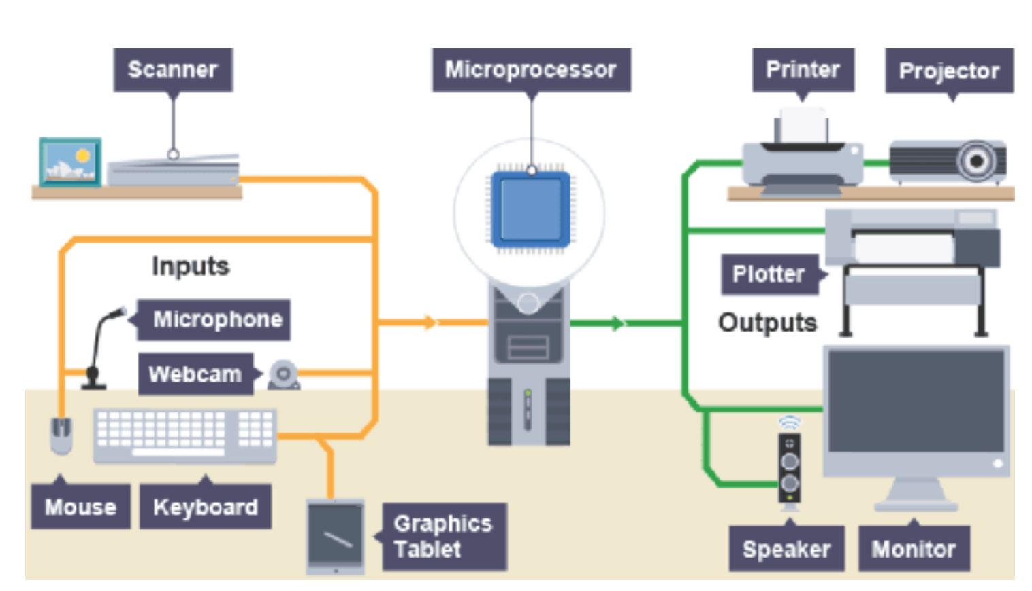
Input/Output Subsystem

Slide 30
Example
Example 1.3. Which of the following computer input device enable video conference?
A: Microphone B: Digital Camera C: Voice recognition
D: Webcam
Example 1.4. The I/O devices are sometimes called the peripheral devices because they surround the CPU and memory of the computer system.
True
False

Slide 31
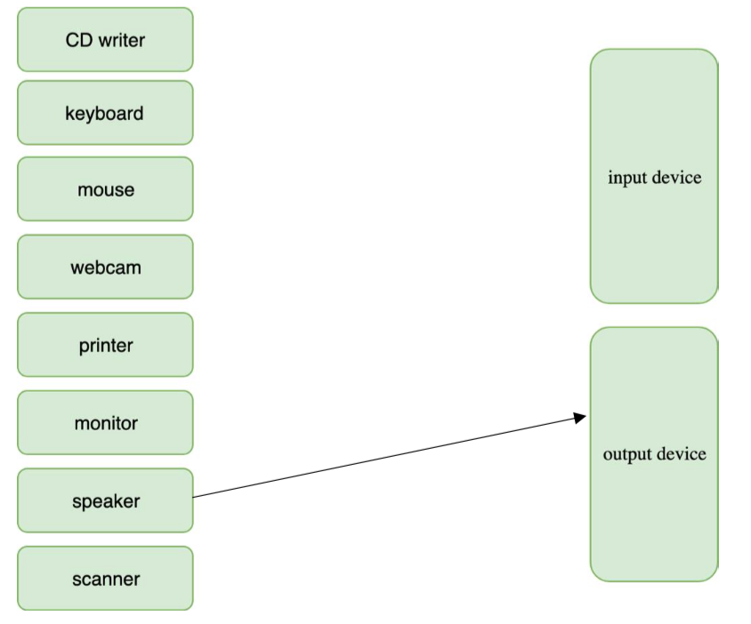
Example
Example 1.5. Please, draw a line between matching items in each column.

Slide 32
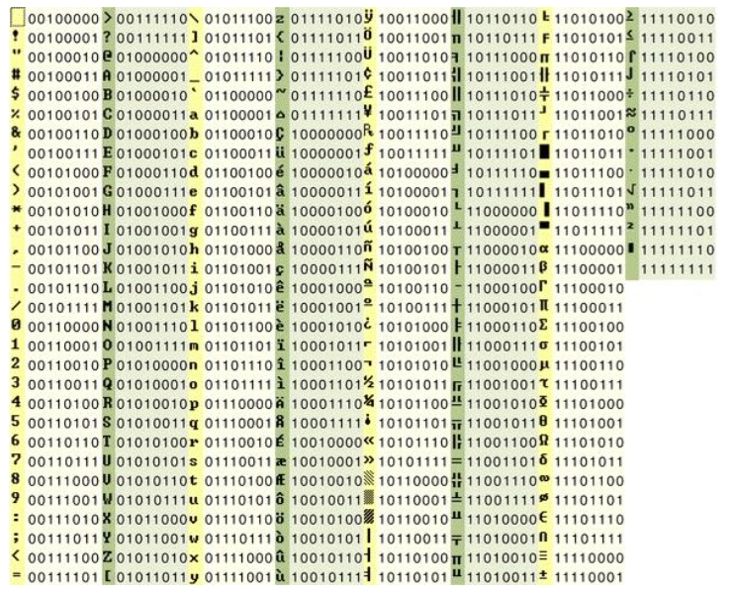
Data Representation
A piece of data, such as an alphabet letter, may be represented using a sequence of binary digits- 0's and 1's. There are several types of codes used to represent character data. For example, using extended ASCII (America Standard Code for Information Interchange) code, the alphabet letter "a" can be represented using a series of eight binary digits, "01100001." Each binary digit is called a bit. And, eight bits is one byte. Extended ASCII code uses eight bits (or one byte) to represent input characters. Below are binary representations of characters in extended ASCII code.

Slide 33
Number Systems
Number Systems
Binary: base 2 (digits 0-1)
Decimal: base 10 (digits 0-9)
Hexadecimal: base 16 (digits 0-9 and A-F)

Slide 34
Binary
Since all numbering-systems are treated the same, you already have all the tools necessary to convert to and from binary. Let's review converting from binary to decimal the number 10110110₂.
The highest place, p, is obtained by counting the number of places in the binary number, starting from zero. In this case, p=7.1×2⁷ +0×2⁶ +1×2⁵ +1×2⁴ +0×2³ +1×2² +1×2¹ +0×2⁰ =1×128+0× 64 + 1 × 32 + 1 × 16 + 0 × 8 + 1 × 4 + 1 × 2 + 0 × 1 = 128 + 0 + 32 + 16 + 0 + 4 + 2 + 0 = 182.
Example 1.6. In 100110₂, the largest place is 2^{p}, where p = 5. Because binary is the easiest numbering system to convert into decimal, it will help us later when we are converting hexadecimal numbers.

Slide 35
Example
Example 1.7. Convert the binary 100101₂ to its decimal equivalent: [(1) x 2⁵] + [(0) x 2⁴] + [(0) x 2³] + [(1) x 2²] + [(0) x 2¹] + [(1) x 2⁰] = [1 x 32] + [0 x 16] + [0 x 8] + [1 x 4] + [0 x 2] + [1 x 1] = 37₁₀.
Output: the decimal equivalent for binary 100101₂ is 37₁₀.

Slide 36
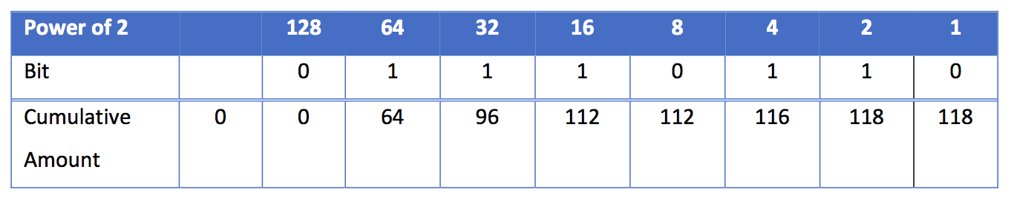
Example
Example 1.8. Give it a try by converting the binary number 01110110 to decimal by filling the table.

Slide 37
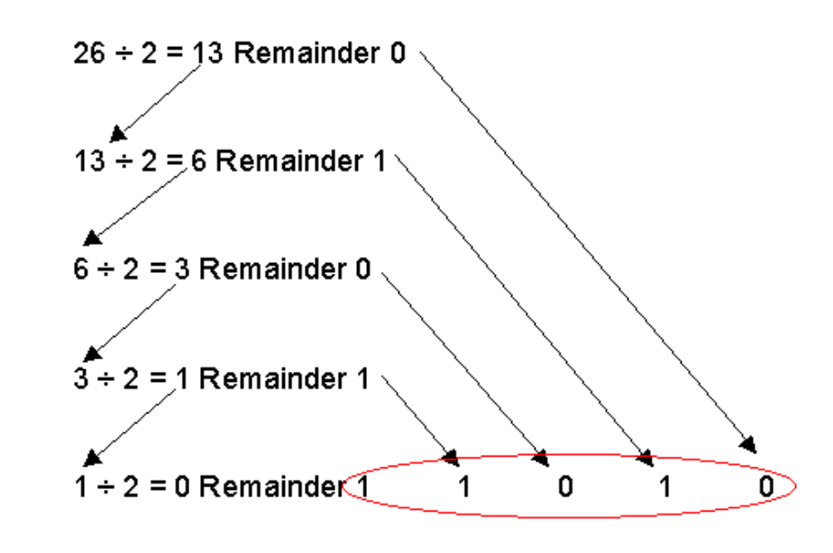
Decimal to Binary
Decimal to Binary: Example 1.9. Convert the decimal 26₁₀ to its binary equivalent

Slide 38
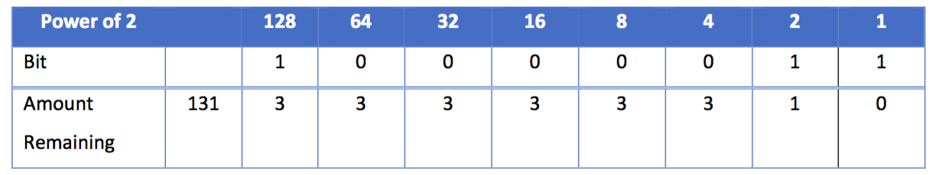
Example
Example 1.10. Give it a try by converting the decimal number 131₁₀ to binary by filling in the table.

Slide 39
Hexadecimal
You should notice that it takes more digits to express a value in binary notation than in decimal notation. For example, the number 99 in decimal is 1100011 in binary. Computer professionals have adopted hexadecimal notation as shorthand for binary so that they can express binary values more concisely. Hexadecimal (base16), or "hex," is most likely the largest numbering system that you will work with. In the modern decimal system, the Arabic number set 0-9 has to be supplemented by additional values to represent the decimal equivalents of 10, 11, 12, 13, 14, and 15. Instead of inventing new symbols to represent these numbers, the letters A-F are used.

Slide 40
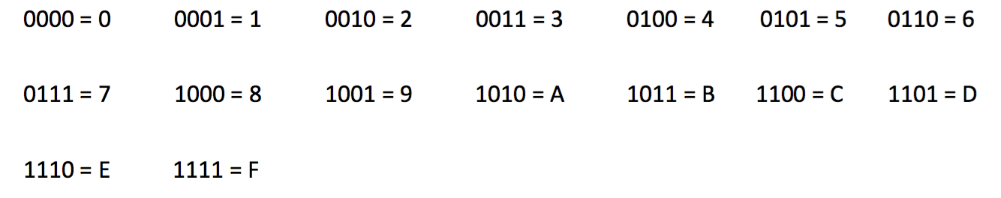
Example
Example 1.11. Convert 4B5A₁₆ to decimal equivalent:
(4 x 16³) + (11 x 16²) + (5 x 16¹) + (10 x 16⁰) = 19290₁₀.
Example 1.12. Use the binary to hexadecimal table to convert the binary number 01101111 to hexadecimal.

Slide 41
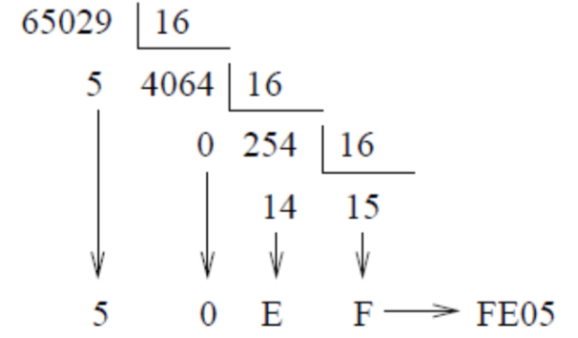
Decimal to Hexadecimal
Example 1.13. Convert 65029₁₀ to hexadecimal:

Slide 42
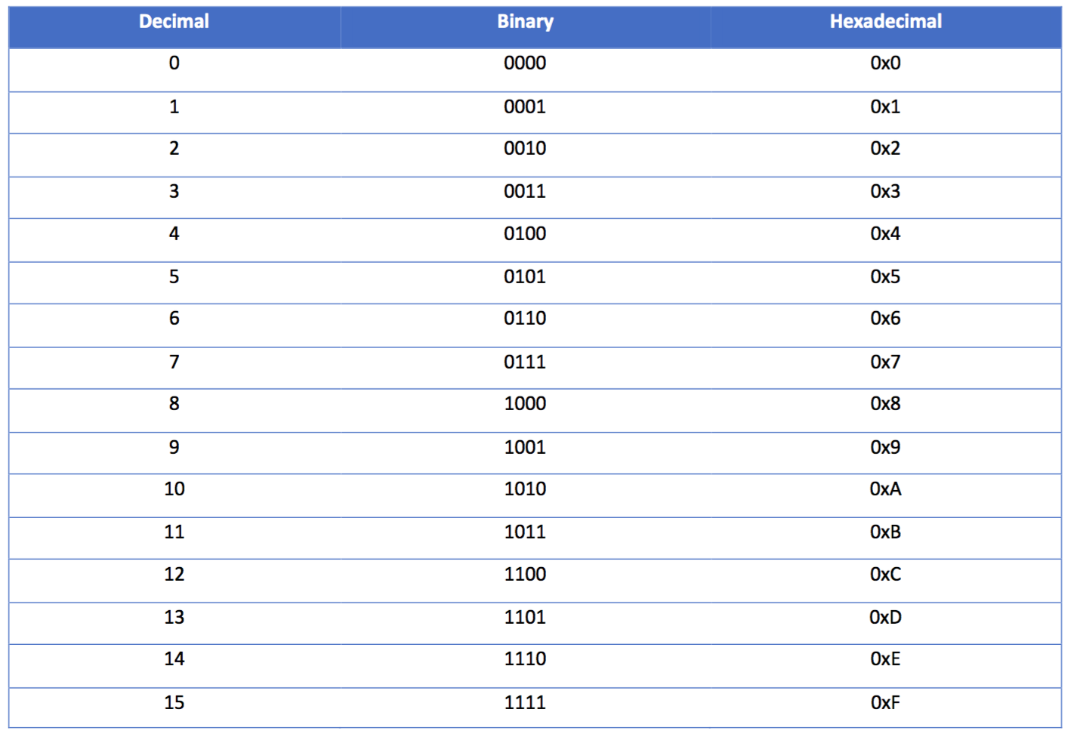
Decimal, binary, and hexadecimal conversions

Slide 43
Thank you for your attention!

